Slide 1
Tracking Session Data

Slide 2

Hidden Fields
URL Rewriting Cookies Sessions

Slide 3

Why we need to track the session data

Slide 4
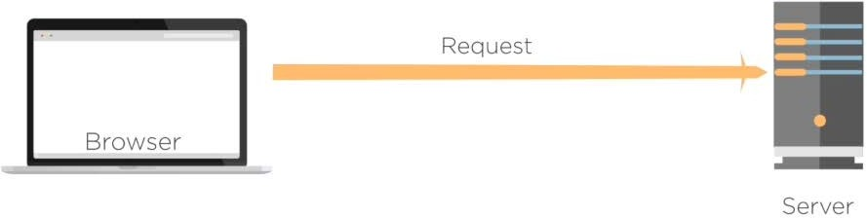
Requirement: Tracking the Session Data

Slide 5
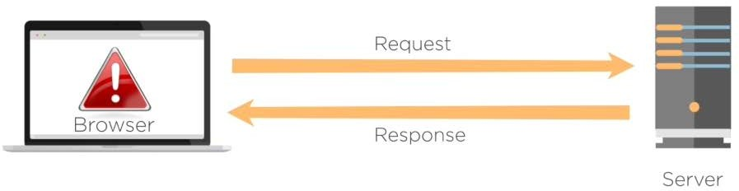
Requirement: Tracking the Session Data

Slide 6
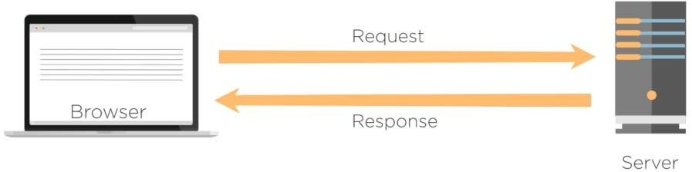
Requirement: Tracking the Session Data

Slide 7
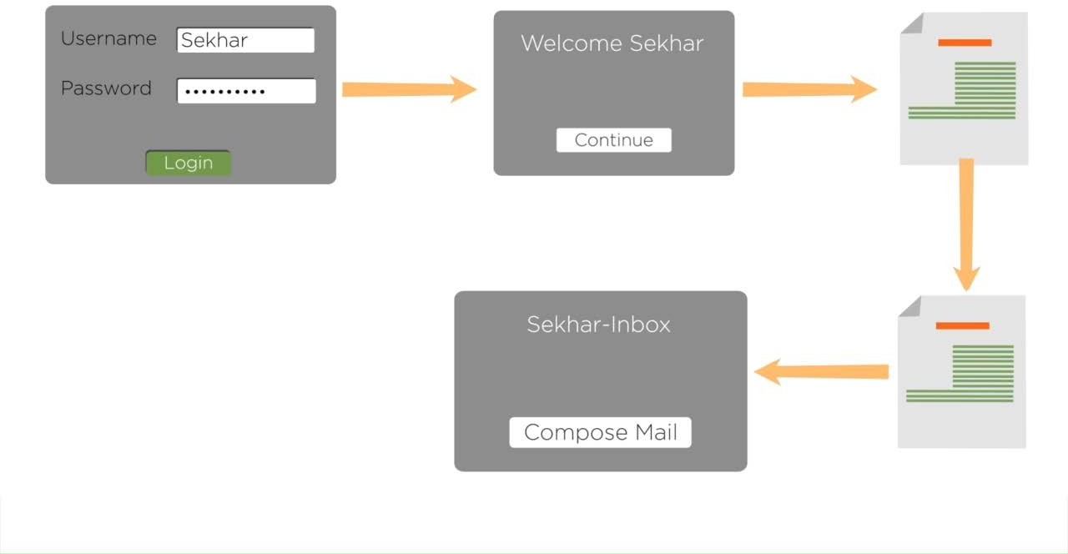

Slide 8
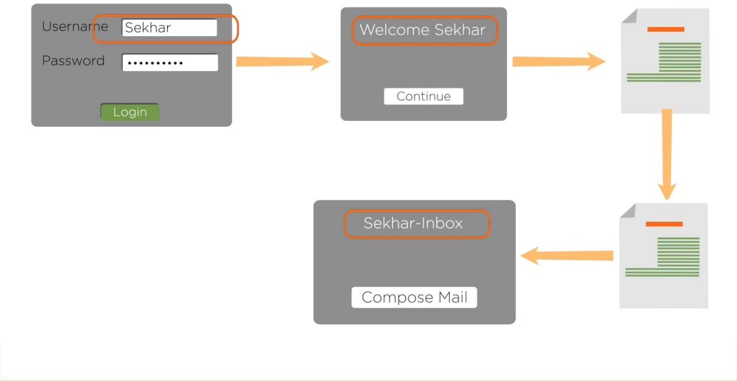

Slide 9
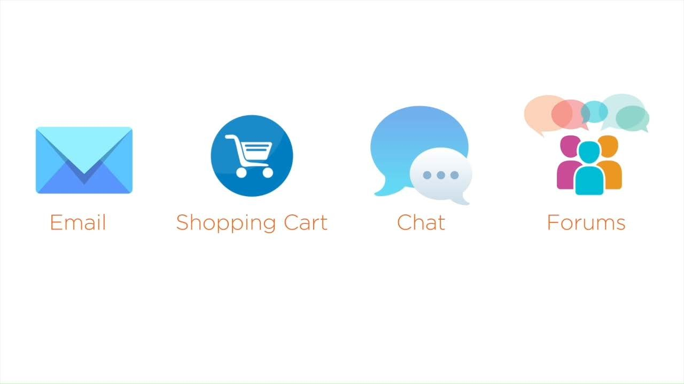

Slide 10
Hidden Fields
Tracking Session Data
URL Rewriting
Cookies
Sessions

Slide 11
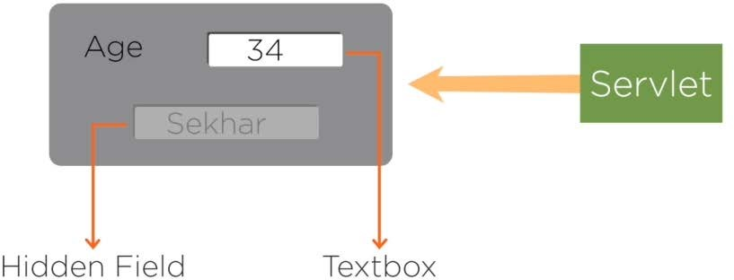
Hidden Form Fields
An HTML Form element used to store the value similar to Textbox

Slide 12
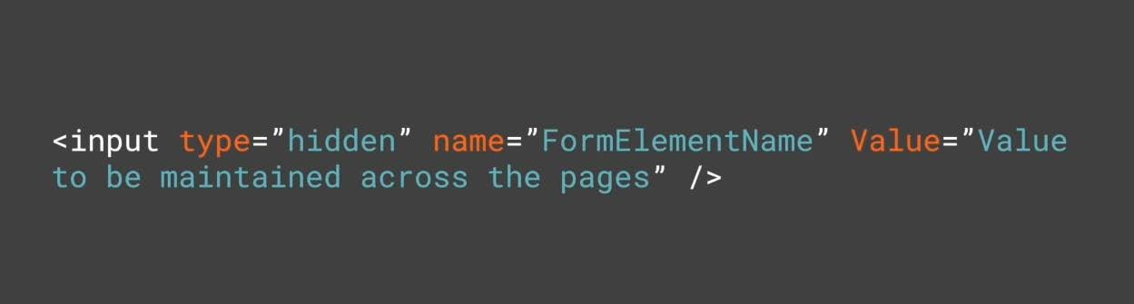
Syntax:
To define an Hidden Form Field

Slide 13
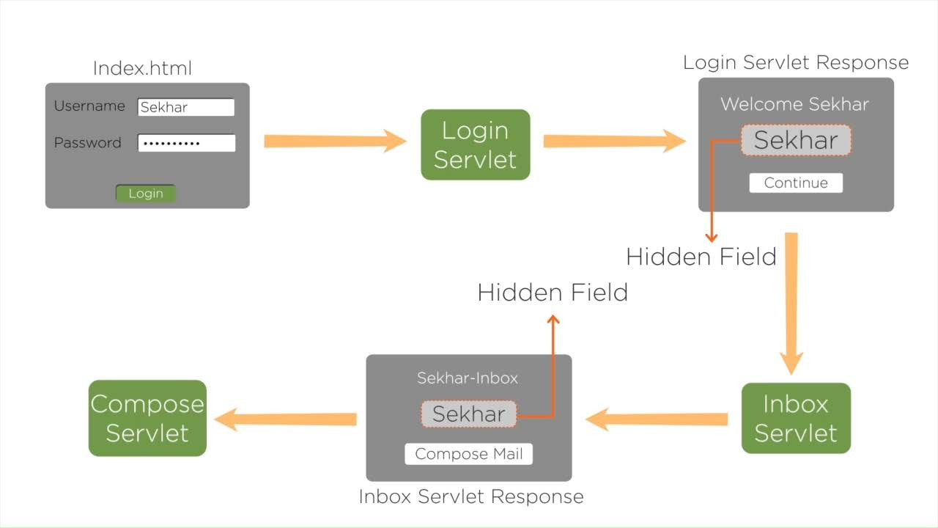

Slide 14
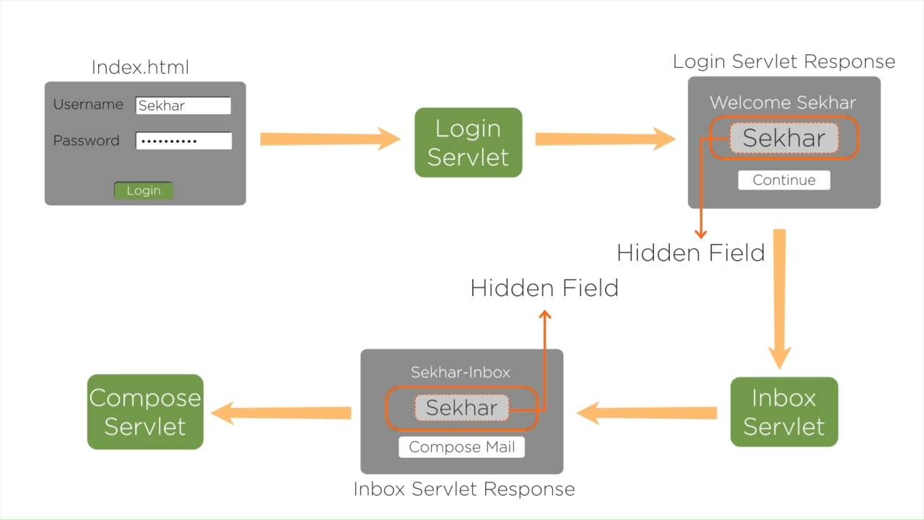

Slide 15
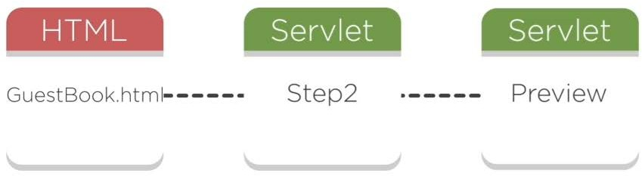
Assisted Practice: Hidden Form Fields

Slide 16
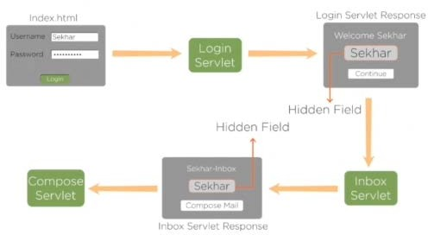

Hidden Form Fields
Pros:
Supported by all browsers
Cons:
Complex to implement
Mandatory to submit the data

Slide 17
URL Rewriting

Slide 18
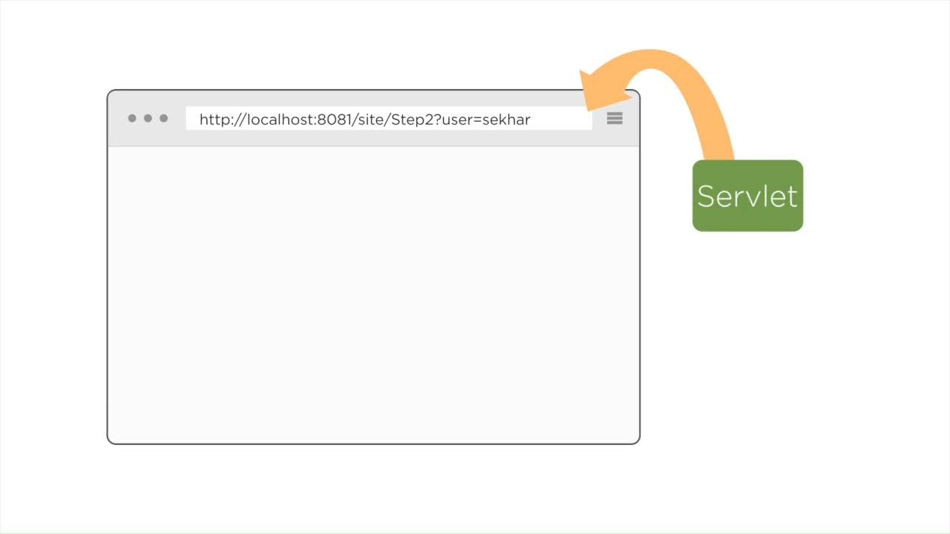

Slide 19
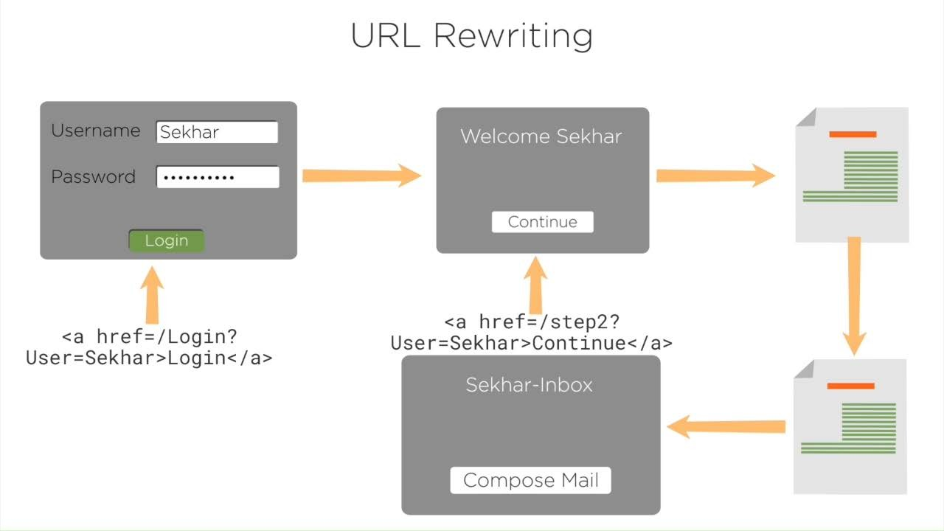
URL Rewriting

Slide 20
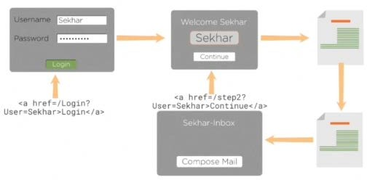

URL Rewriting
Pros:
Supported by all browsers
Doesn't depend on browser capabilities
Cons:
Works only with Hyperlinks
Can submit only text information Complex to implement

Slide 21
Handling Cookies in Servlets

Slide 22
Cookies are used to store the server side information at the client system

Slide 23
Types Of Cookies
Session or Temporary Cookies
Persistent or Permanent Cookies

Slide 24
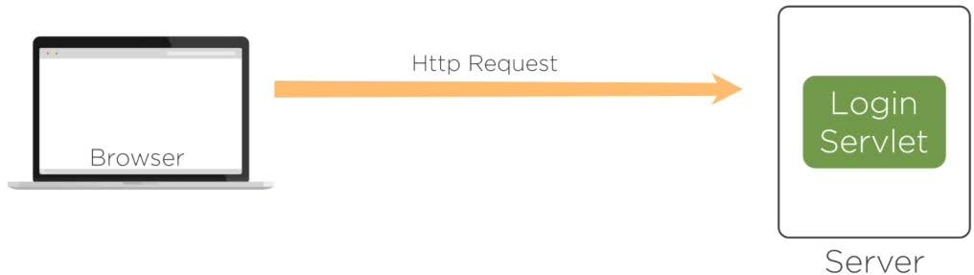
Handling Cookies in Servlets

Slide 25
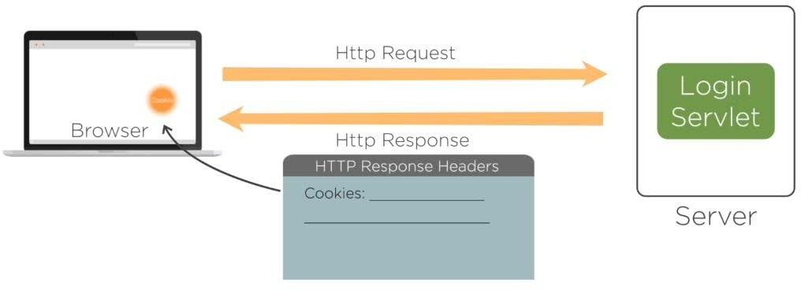
Handling Cookies in Servlets

Slide 26
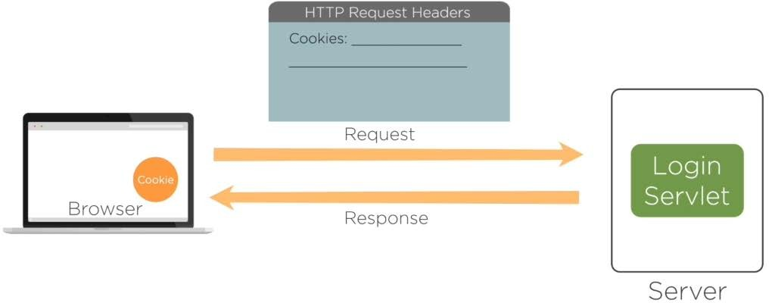
Handling Cookies in Servlets

Slide 27
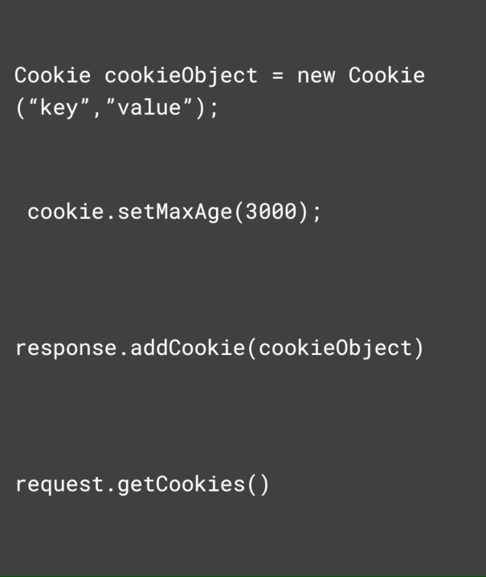
To Create an object for the Cookie
To set the expiration period for the Cookie
To add the Cookie object
To retrieve the Cookie information

Slide 28
setDomain(String pattern) getDomain() setMaxAge(int expiry) getMaxAge()
Methods to Manipulate Cookies
getName() setValue(String newValue) getValue()
setPath(String uri) getPath() setSecure(boolean flag)
serComment(String purpose) getComment()

Slide 29
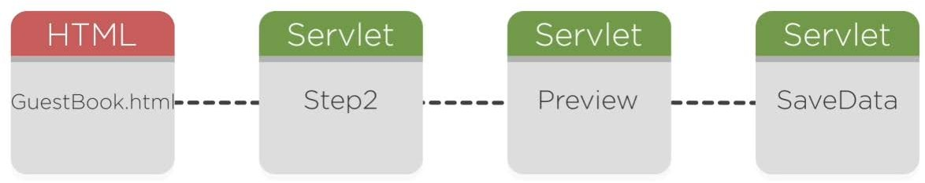
Assisted Practice: Handling Cookies in Servlets

Slide 30
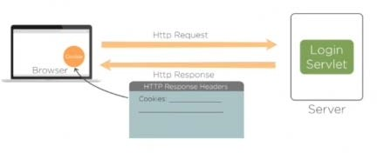
Handling Cookies in Servlets
Pros:
Easy to implement Performance will be fast
Can store huge information for a longer period
Cons:
Cookies depends on browser capabilities
Not advisable to store secure data Can maintain only String information

Slide 31
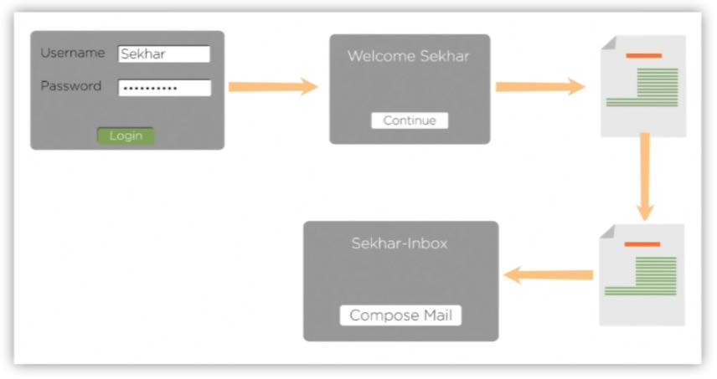
Handling Sessions in Servlets
Sessions are used to maintain the user information at the server side temporarily such that the values can be accessed across the Servlets within the web applications

Slide 32
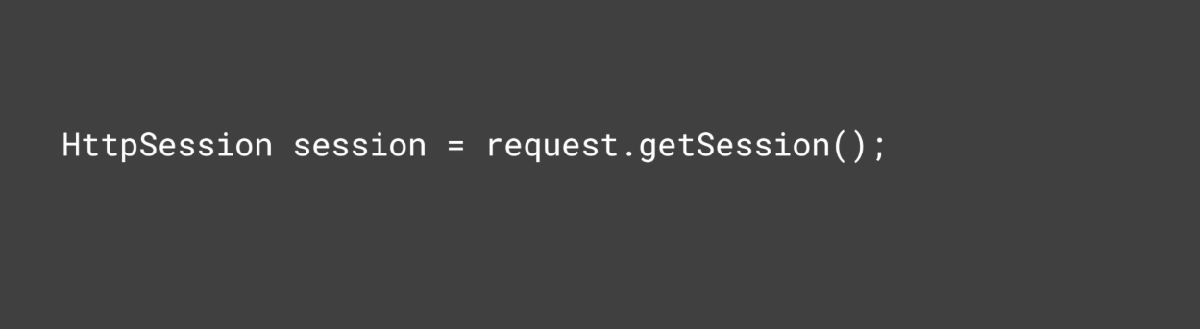
Handling Sessions in Servlets
Syntax:
To Create an HttpSession Object
Call request.getSession() before we send any content to the client

Slide 33
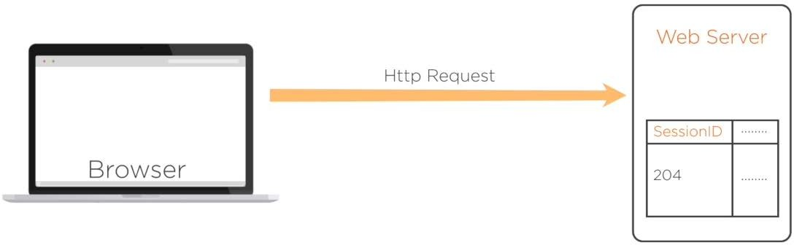
Handling Sessions in Servlets

Slide 34
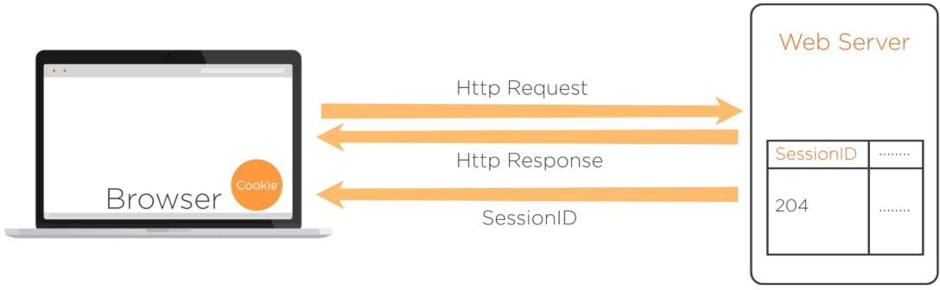
Handling Sessions in Servlets

Slide 35
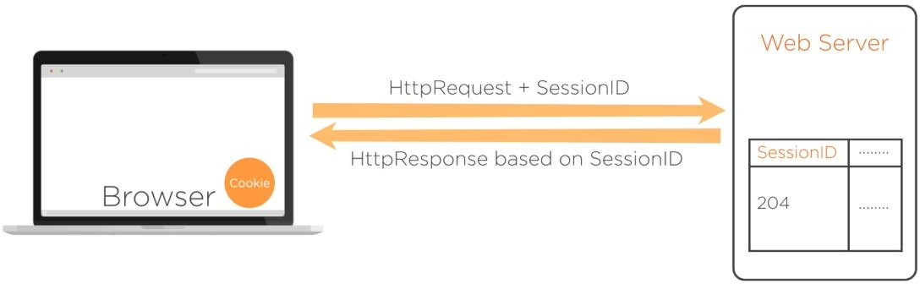
Handling Sessions in Servlets

Slide 36
getAttribute(String name) getAttributeNames() getCreationTime()
Methods to Track the Session Data
getId() getLastAccessedTime() getMaxInactiveInterval() invalidate()
isNew() removeAttribute(String name)
setAttribute(String name,object value) setMaxInactiveInterval(int interval)

Slide 37

Assisted Practice
Handling Sessions in Servlets

Slide 38
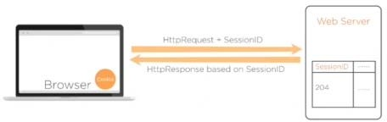
Handling Sessions in Servlets
Pros:
Easy to implement
Can store String and Object type of data as value
Data is secured
Cons:
Not advisable to store data for long period Not advisable to store huge data
Sessions depends on browser capabilities

Slide 39
Assisted Practice
Session Login and Logout

Slide 40

Hidden Fields
URL Rewriting Cookies Sessions

